Slide 1
Core Java

Slide 2
About trainer
14+ years experience.
Full time software testing manual & automation trainer.
ISTQB certified Tester
Conducted trainings for multiple corporates.
Trained 1000+ professionals.
You tube channel “Automation With Priyanka”.

Slide 3
Programming Languages
Programming languages allow programmers to develop software.
The two major families of languages are
Low Level Language
Machine languages
Assembly languages
High-Level Languages

Slide 4
Programming Languages
Machine Languages :
Comprised of 1s and 0s
The “native” language of a computer
Difficult to program
Assembly Languages :
Assembly languages are a step towards easier programming.
Assembly languages are comprised of a set of elemental commands which are tied to a specific processor.
Assembly language code needs to be translated to machine language before the computer processes it.

Slide 5
Programming Languages
High-Level Languages :
High-level languages represent a giant leap towards easier programming.
The syntax of HL languages is similar to English.
HL languages are divided into two groups
Procedural languages
Object-Oriented languages (OOP)

Slide 6
Procedural vs. Object-Oriented
Procedural Languages
Procedural languages are characterized by sequential sets of linear commands.
Follows top down approach
The focus of such languages is on structure.
Examples include C, COBOL, Fortran, LISP, Perl, HTML, VBScript.
Object-Oriented Languages
The focus of OOP languages is not on structure, but on modeling data.
Follows bottom up approach
Programmers code using “blueprints” of data models called classes.
Examples of OOP languages include C++, Visual Basic.NET and Java.

Slide 7
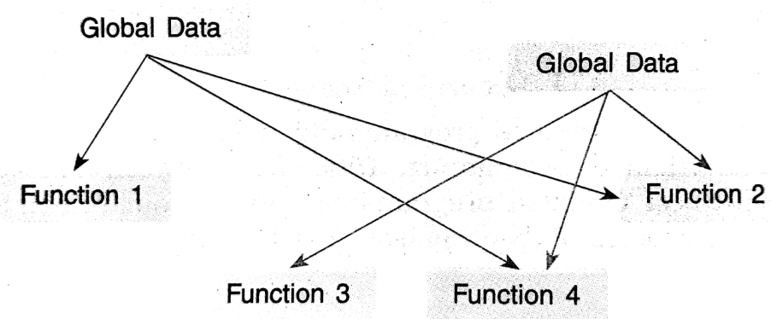
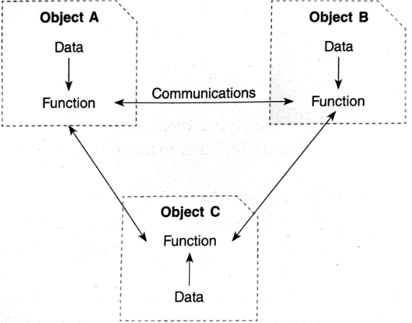
Procedure Oriented
Object Oriented

Slide 8
Difference C,C++,Java
Metrics | C | C++ | Java
Programming Paradigm | Procedural Language | Object Oriented Language | Pure Object Oriented Language
Origin | Based on Assembly Language | Based on C Language | Based on C & C++
Developer | Dennis Ritchie in 1972 | Bjarne Stroustrup in 1979 | James Gosling in 1991
Translator | Compiler Only | Compiler Only | Interpreted Language(Compiler+ Interpreter)
Platform Dependency | Platform Dependent | Platform Dependent | Platform Independent
Code Execution | Direct | Direct | Executed by JVM(Java Virtual Machine)
Approach | Top-down | Bottom-up | Bottom-up
File generation | .exe file | .exe file | .class file

Slide 9
Metrics | C | C++ | Java
Pre-processor directives | Support header files(#include, #define) | Supported (#header, #define) | Use Packages (import)
Keywords | Support 32 keywords | Support 63 Keywords | Support 50 Keywords
Inheritance | No Inheritance | Supported | Supported except Multiple Inheritance
Overloading | No Overloading | Support Function Overloading | Support Function Overloading
Pointers | Supported | Supported | Not Supported
Exception Handling | Not Supported | Supported | Supported
Allocation | Use malloc, calloc | Use new , delete | Garbage Collector

Slide 10
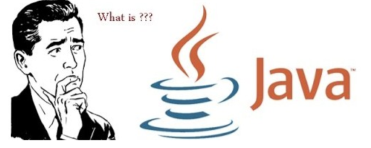
History
Java is an object oriented programming language and runtime environment.
Java is a high level, robust, object-oriented and secure programming language.
Java was developed by Sun Microsystems (which is now the subsidiary of Oracle) in the year 1995.
James Gosling is known as the father of Java. Before Java, its name was Oak. Since Oak was already a registered company, so James Gosling and his team changed the Oak name to Java.

Slide 11
What is Java
Java is a programming language expressly designed for use in the distributed environment of the Internet.
Java can be used to create complete applications that may run on a single computer or be distributed among servers and clients in a network.

Slide 12
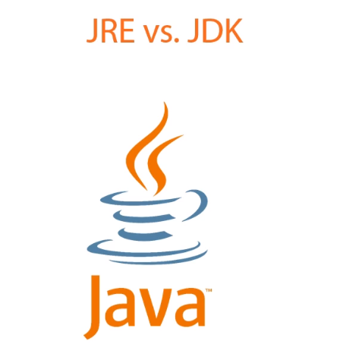
Java Vocabulary

Slide 13
JVM(Java Virtual Machine)
It is an abstract machine.
It is a specification that provides a run-time environment in which Java bytecode can be executed.
JVM is the virtual machine that runs the Java bytecodes
The JVM does not understand Java source code, that is why you compile your *.java files to obtain *.class file that contains the bytecodes understood by the JVM
The same bytecodes give the same results makes java a platform Independent Language(Write Once ,Run Anywhere)

Slide 14
JRE(Java Runtime Environment)
JRE refers to a runtime environment in which Java bytecode can be executed.
It implements the JVM (Java Virtual Machine) and provides all the class libraries and other support files that JVM uses runtime.
JRE is a software package that contains what is required to run a Java program. Basically, it’s an implementation of the JVM which physically exists.
JRE=JVM +Set of Libraries +Other Additional files
The JRE does not contain tools and utilities such as compilers or debuggers for developing applets and application

Slide 15
JDK(Java Development Kit)
The JDK completely includes JRE which contains tools for Java programmers.
The Java Development Kit is provided free of charge.
Along with JRE, it includes an interpreter/loader, a compiler (javac), an archiver (jar), a documentation generator (Javadoc) and other tools needed in Java development.
In short, it contains
JDK= JRE + development tools.
JDK=JVM+ Set of libraries +Other Additional files +Development tools

Slide 16
JRE vs. JDK
Java Runtime Environment(JRE)
Required to run Java apps
End-user normally require only the JRE.
Java Development Kit(JDK)
Provides tools required to create Java apps
Developers normally require the JDK
JDK installation includes JRE

Slide 17
JDK Architecture
JDK
JRE
Development tools
Set of Libraries
Other Files
JVM

Slide 18
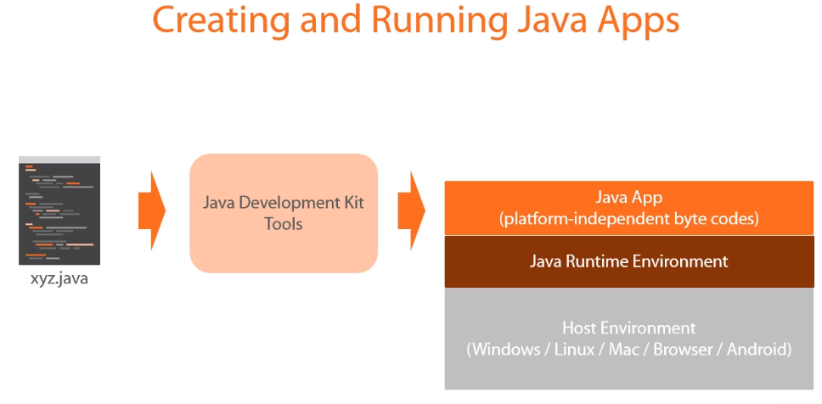

Slide 19
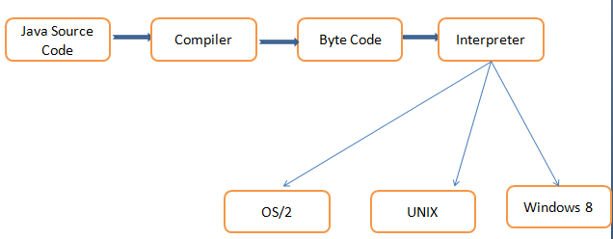
Java Execution
High level Language→Compiler→Machine Language(Object code)
High level Language→Interpreter→Machine Language(Object Program)

Slide 20
OOP Fundamentals(Object)
OBJECT is an identifiable entity with some characteristics and behavior.
In OOP programming , object represents an entity that can store data and has its interface through functions.
The object is an instance of a class and an object is a real-world entity.
To access the members which are defined in the class you need to create an object.
for example: a chair, pen, table, bike, book, etc are the example of Object.

Slide 21
OOP Fundamentals(Class)
Class is simply a representation of similar types of objects.
It is the blueprint/plan/templates that describes the details of object.
Class contains
Methods
Fields/variables
Constructors
Blocks
Interfaces

Slide 22
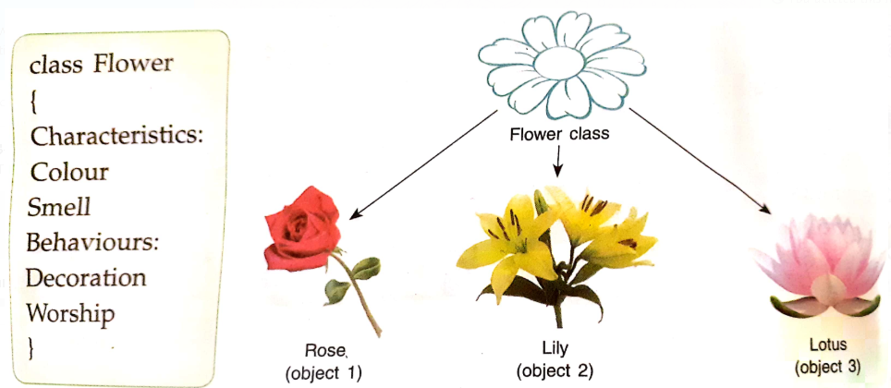
Concept of Class & Object

Slide 23
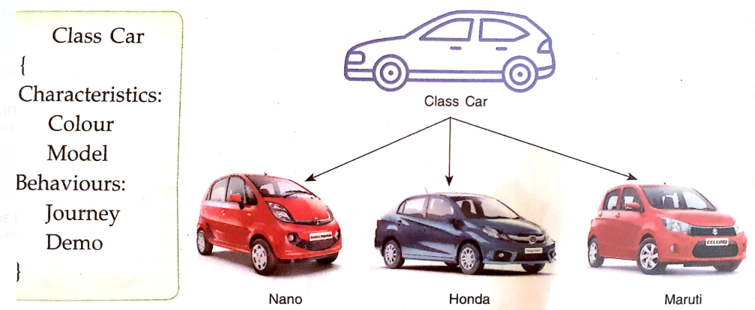

Slide 24
Example Of Java Program
public class Hello
{
public static void main(String args[])
{
System.out.println("Hello World !");
}
}
/* OUTPUT Hello World ! */

Slide 25
Details
1.class keyword is used to declare a class in java.
2.public keyword is an access modifier which represents visibility.
It means it is visible to all.
3.static is a keyword. If we declare any method as static,
it is known as the static method.
4.void is the return type of the method. It means it doesn't return any value.
5.main represents the starting point of the program.
6.String[] args is used for command line argument.
7.System.out.println() is used to print statement.
Here, System is a class, out is the object of PrintStream class,
println() is the method of PrintStream class.

Slide 26
Java Compilation and Execution
JDK
Java Source
HelloWorld.java
Java Compiler
javac
Byte Code
HelloWorld.class
JRE
Javaw,
libraries
JVM
Executes Program

Slide 27
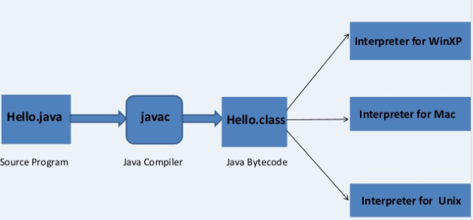
Java Program Translation

Slide 28
Basic Features
Java is an Object Oriented programming language
Java program are both compiled and interpreted.
It can access data from a local system as well as from net.
Java programming is written within a class (Variable & functions declare and defined in the class).
Java program can create Applets(Program download from internet) and Applications(Program developed by user)
Java is case sensitive.

Slide 29
Class & Object Details

Slide 30
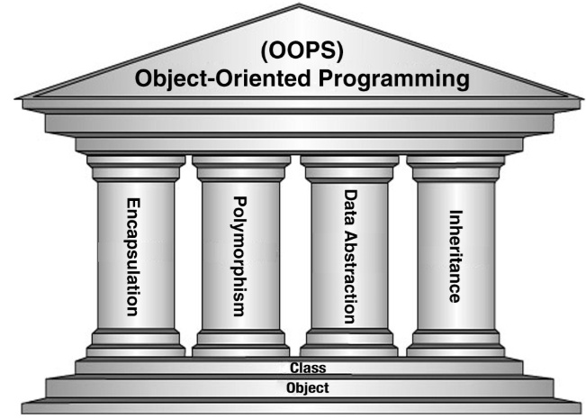
Pillars Of Object Oriented

Slide 31
Encapsulation
Encapsulation refers to the bundling (combining) of data with the methods (member functions that operate on that data) into a single entity called an Object.
Encapsulation is used to hide the values or state of a structured data object inside a class, preventing unauthorized parties to have direct access with data.
Encapsulation is achieved using private access modifier.

Slide 32
Polymorphism
Polymorphism is an object-oriented programming concept that refers to the ability of a variable, function or object to take on multiple forms.
Polymorphism refers to a programming language ability to process objects differently depending on their data type or class
Polymorphism is the process of using a function /method for more than one purpose.
Ways:
Method Overloading
Method Overriding

Slide 33
Data Abstraction
Abstraction provides a generalized view of classes or object by providing only the relevant information.
Abstraction is a process of hiding the implementation details and showing only functionality to the user.
Through the process of abstraction, a programmer hides all but the relevant data about an object in order to reduce complexity and increase efficiency.
Abstraction is the process of hiding the working style of an object, and showing the information of an object.
Can be done using Interface and Abstract classes.

Slide 34
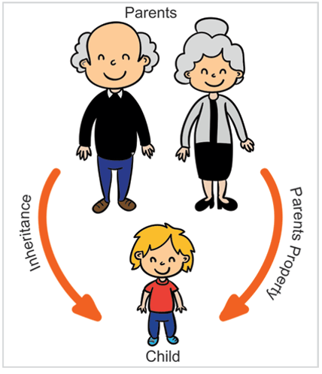
Inheritance
Inheritance is a process by which object of one class acquire the properties from the object of another class.
Inheritance also enables you to write generic code which applies to all classes in an inheritance hierarchy.
Using the concept of inheritance, the programmer can create as many derived classes from the base class as needed while adding specific features to each derived class as needed.

Slide 35
Fundamentals

Slide 36
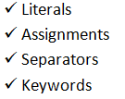

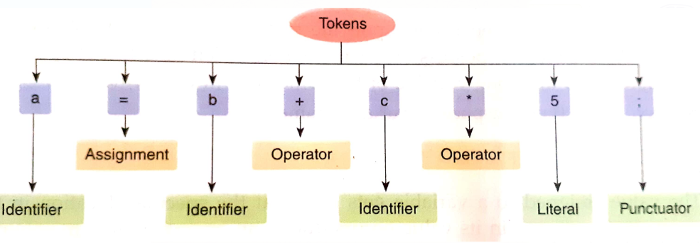
Tokens
Token can be defined as each individual component of a java statement in such way that it carries some meaning and takes part in effective execution of the program.

Slide 37
Keywords
Java keywords are also known as reserved words.
These are predefined words by Java so it cannot be used as a variable or object name.
Each Keyword starts with small letter.
There are total 50 keywords in java, out of which 2 are not currently been used.
(goto & constant are removed, constant is replaced by final keyword in java)

Slide 38
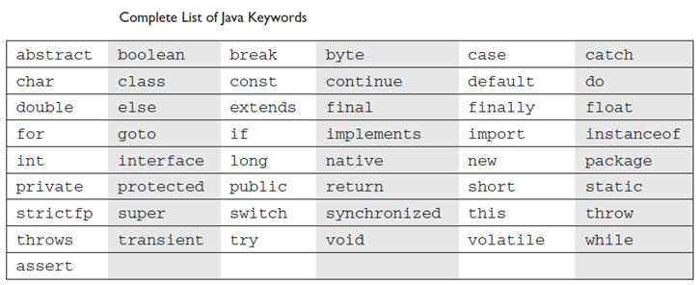

Slide 39
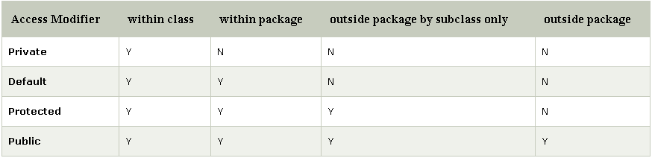
Access Modifiers
Java provides a number of access modifiers to set access levels for classes, variables, methods and constructors.
Access modifiers help to implement encapsulation principle of object orientation programming
The four access levels are:
Default : Visible to the package( No modifiers are needed).
Private : Visible to the class only .
Public : Visible to the world.
Protected : Visible to the package and all subclasses

Slide 40
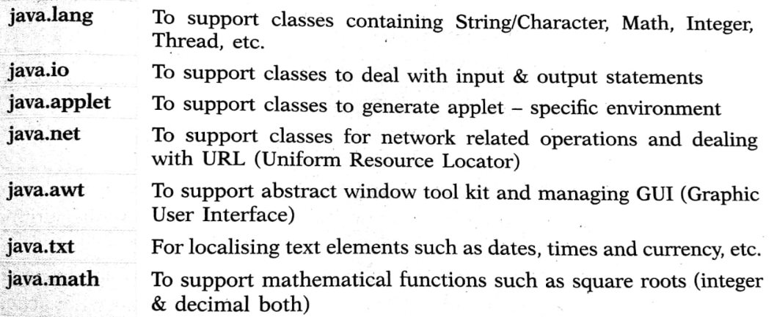
Package
Java package is a group of similar types of classes, interfaces and sub-packages.
Types
Build-In Package➔java.io.*, java.lang .*, java.util.*
User-Defined Package

Slide 41
Class
A class is a collection of fields (data) and methods (procedure or function) that operate on that data.
Syntax: Example:
class ClassName public class Student
{ {
// declare fields int id;
//declare methods public void show()
{
Hello
}
} }

Slide 42
Object
Need of object
To access the data field.
To access the method
Creating object : new keyword is used to create object
Syntax
classname object_name = new classname();
Test obj1=new Test();
Test obj2=new Test();

Slide 43
Accessing Member of Class
The members are accessed using the .(dot) operator.
Syntax:
object_name.data_field; object_name.method_name(parameter list);
Example:
obj1.x=34;
obj2.x=56;
obj1.square(4)
Here obj1,obj2 are objects , x is a data field and square is the method_name.

Slide 44
Operators
Operators are special characters within the Java language to manipulate primitive data types.
Different Operators in JAVA
Assignment Operators : =
Arithmetic Operators : - + * / % ++ --
Relational Operators : > < >= <= == !=
Logical Operators : && || !
Conditional Operator : ?

Slide 45
Variables & Data Types In Java
High level Agenda
What is Variable
Types of Variable
Local Variable
Instance Variable
Class/Static Variable
Data Types
Primitive
Non-Primitive
Examples

Slide 46
What is variable?
Variable is name of memory location to store values.
We use variable to store data & use the data once it is required.
Local Variable:
A variable that declare inside the method/block is called local variable
Instance Variable:
A variable that declares inside the class but outside the methods , constructors or any block is called an Instance variable
Class/Static Variable:
A variable declare inside the class with static modifier , these variables have only one copy that is share by all the different objects in a class.

Slide 47
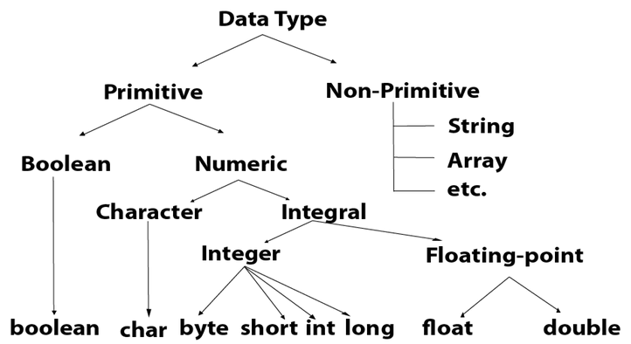
Data Types
Data types specify the different sizes and values that can be stored in the variable.
Two types of data types.
Primitive data types
Non-primitive data types

Slide 48
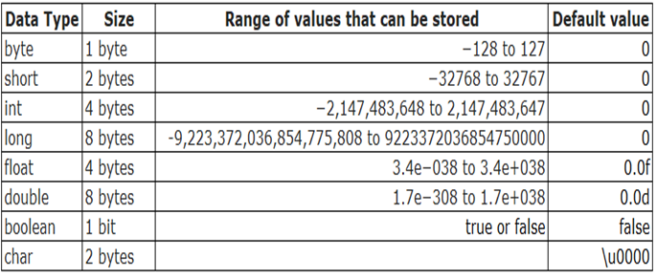
1 byte=8 bits

Slide 49
Demo
Boolean
Character
Integer
Floating-point
Local Variable
Instance Variable
Static Variable

Slide 50
Type Conversion
Type casting is nothing but assigning a value of one primitive data type to another(we should know compatibility of data type).
Two types
1.Widening Casting (automatically) – This involves the conversion of a smaller data type to the larger type size.
byte -> short -> char -> int -> long -> float -> double
2.Narrowing Casting (manually) – This involves converting a larger data type to a smaller size type.
double -> float -> long -> int -> char -> short -> byte

Slide 51
Implicit Type Casting
Widening
This type of casting takes place when two data types are automatically converted. It is also known as Implicit Conversion.
This happens when the two data types are compatible and also when we assign the value of a smaller data type to a larger data type.
The numeric data types are compatible with each other but no automatic conversion is supported from numeric type to char or boolean.
Eg. Int num=18
float f=num
System.out.println(num)➔18
System.out.println(f)➔18.0

Slide 52
Explicit Type Casting
Narrowing
In this case, if you want to assign a value of larger data type to a smaller data type, you can perform Explicit type casting or narrowing.
This is useful for incompatible data types where automatic conversion cannot be done.
Eg.
Double d=28.56
//assigning double value to integer will loss precision
Int num=(int)d
System.out.println(num)➔28

Slide 53
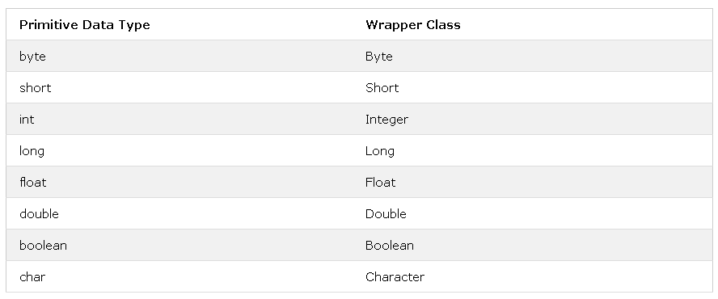
Wrapper class
Wrapper classes provide a way to use primitive data types (int, boolean, etc..) as objects.

Slide 54
Constructor
In java constructor is a block of codes similar to the method .
It is called when instance of a class is created.
Constructor is used to initialize Object
Every time object is created using new keyword, at least one constructor is called.
It calls default constructor if there is no constructor is available.
Types
Default constructor
Parameterized constructor

Slide 55
Rules For Constructor
Constructor name must be same as its class name.
Constructor must have no explicit return type.
A java constructor can not be abstract ,static, final & synchronized.
Demo on static variable

Slide 56
This Keyword
this can be used to refer current class instance variable.
this can be used to invoke current class method (implicitly)
this() can be used to invoke current class constructor.
this can be passed as an argument in the method call.
this can be passed as argument in the constructor call.
this can be used to return the current class instance from the method.

Slide 57
Methods
Method is just a block of java statement that performs a particular task.
Syntax:
Type Methodname()
{
//Body of Method
}
Examples:
Calculate_EMI();
Calculate_Result();
Start_browser();
Close_browser();

Slide 58
Methods Facts
Instance(Non-static)method can be called through object using (.) dot operator.
Static method can be called using class name directly using (.) dot operator.
Demo.
Non-static
static

Slide 59
Static Fields, Method
When variable declared with static keyword is called static field or class variable.
Every object shares a class variable.
A Method declared with static keyword is called static method.
Static method can be invoked using the class name.

Slide 60
Static Block
A class can have static block which belongs to the class.
This block will be executed even before main is invoked.
This block is executed only when the class is loaded
Its main purpose is to initialize static variable.

Slide 61
Passing parameter & return values
What is parameter?
To make our program dynamic we can pass parameter while calling methods.
Parameter can be passed compile time and run time as well.
Demo

Slide 62
Scanner Class
Scanner class in java is found in the java.util package.
A Scanner breaks its input into tokens using a delimiter pattern, which by default matches whitespace.
The resulting tokens may then be converted into values of different types using the various next methods.
Example:
Int → nextInt()
String→ nextLine()
Byte→nextByte() & so on
To get instance of java scanner which reads input from the user ,we need to pass the input stream (System.in) in the constructor of scanner class.
Example: Scanner sc=new Scanner(System.in);

Slide 63
Demo
Create simple program to accept Name of user and display the same.
Create simple program to accept two numbers from user and display the addition of the same.

Slide 64
Control Flow Statements
Java Control Flow statements
Jumping statements
Conditional Statements
Loop Statements
break
return continue
If Else
Switch Case
For
While
Do- while

Slide 65
If Statement
The if-then statement is the most basic of all the control flow statements.
It tells your program to execute a certain section of code only if a particular test evaluates to true.
Syntax:
if(condition)
{
block of code;
}

Slide 66
If –else Statement
The if-then-else statement provides a secondary path of execution where true and false both condition get evaluated.
Syntax :
if(condition)
{ block of statements;
}
Else
{
block of statements;
}

Slide 67
Nested-if Statement
It is Similar to If-Else, but one if inside another is just to verify multiple condition.
Syntax
If(Condition1)
{
}else if(Condition2)
{
}else { }

Slide 68
Switch Statement
The switch statement have a number of possible execution paths.
A switch works with the byte, short, char, and int primitive data types.
Syntax:
switch(condition)
{
case 1: block of code;
break;
case 2: block of code;
break;
default: block of code;
}

Slide 69
Points for Switch Statement
Data type should be same for comparison .
We can have multiple cases.
We can use only integers, String.
Break is optional but if not provided it will check all cases till end.
Default is optional.

Slide 70
Example Switch-Case
Write a program to display employee performance as
1.Poor Performance
2.Need to Improve
3.Good Performance
4.Excellent Performance
5.Employee of the year

Slide 71
Assignments
Find largest number among two numbers.
Take three numbers from the user and print the greatest number.
Program to check number is even or odd.
Check given number is equal to 10,50 & 100.
Check number is positive or negative.

Slide 72
Loop Statements In Java
Loop is general concepts in any programming language which will allows you to run certain piece of code multiple times.
Examples:
Read data from file
Fetch records from database

Slide 73
For Loop
The for statement provides a compact way to iterate over a range of values.
The general form of the for statement can be expressed as follows.
Syntax:
for (initialization; termination; increment)
{
statement(s)
}

Slide 74
Enhanced For Loop
The for statement also has another form designed for iteration through Collections and arrays .
This form is sometimes referred to as the enhanced for statement, and can be used to make your loops more compact and easy to read.
Syntax:
for(int value: collection/array)
{
Block of statements;
}

Slide 75
While Loop
The while statement continually executes a block of statements while a particular condition is true.
Its syntax can be expressed as:
while (expression)
{
statement(s);
//increment/decrement;
}
It is called as the entry controlled loop.

Slide 76
Do-While Loop
The Java programming language also provides a do-while statement, which can be expressed as follows.
Syntax :
do
{
statement(s)
} while (expression);
It is called as the exit control loop

Slide 77
break , continue & return statements
break statement :The break Statement is generally used to break the loop and switch statement.
return statement : The return statement is used to explicitly return from a method.
continue statement : The continue statement in Java is used to skip the part of loop.

Slide 78
Assignments
1.Print numbers from 1 to 100.
2.Check factorial of number
3. Swapping of two number
3.Check number is palindrome (121 reverse 121)
4. Check number is Armstrong number.(153)LogicCube+
5.Print table from 1 to 10.
6. Pattern examples
1. 2. 3.
* **** 1
** **** 2 2
*** **** 3 3 3
**** **** 4 4 4 4

Slide 79
Array in Java
An Array is a data structure which store the sequential elements of the same type.
Array is collection of similar data types.
Main advantage is it improve readability of the code
Types:
1D array & Multiple(2D) array
Syntax: Single Dimensional
datatype arrayname[]=new datatype[size]
int a[]=new int[3];
Array are internally implemented as object hence by using new operator we can construct an array.

Slide 80
Multi-Dimensional (2-D)Array
In java multi-dimensional array are implemented as single dimensional arrays.
This approach improves performance with respect to memory.
Syntax:
Datatype arrayname=new datatype[size][size]
int a[][]=new int [3][3];

Slide 81
For each example -2D Array
String s[][]={{“A”,”B”},{“C”,”D”,”E”}};//2 rows & 3 cols
for(String x[]:s)//row wise data get store in 1-d array.
{
for(String y:x)//x data get assign to y
{
System.out.println(y)//y will print output
}
}

Slide 82
String Class in java
String is a class belongs to Java.lang.*
String class has many inbuilt methods which will help you to perform operations on string.
Example:
Comparing,Converting,split,Concatinate so on.

Slide 83
String is Class
Object class
String class

Slide 84
String methods
startsWith() & endsWith()
equals() & equalsIgnoreCase()
split(expression)
trim() : eliminates white space before and after string
charAt(): return a character at specified index.
Concat()

Slide 85
Verify Browser Assignment
Write a Program to verify Browser (IE,Mozilla,Safari,Chrome) where if user enters browser name then the system must display browser name with appropriate message. (Note->Using String functions)
Eg.
If user enter chrome
Message must be “User is on chrome”

Slide 86
Encapsulation
Encapsulation in Java is a mechanism of wrapping the data (variables) and code acting on the data (methods) together as a single unit.
In encapsulation, the variables of a class will be hidden from other classes, and can be accessed only through the methods of their current class. Therefore, it is also known as data hiding.
To achieve encapsulation in Java :
Declare the variables of a class as private.
Provide public setter and getter methods to modify and view the variables values.

Slide 87
Polymorphism in Java
What is Polymorphism?
In simple word one thing in different form.
Examples:
Add()
Add(int a ,int b)
Add(int a ,intb , int c)
Types:
Compile time
Overloading
Early binding
Run time
Overriding
Late binding

Slide 88
Polymorphism Compile time with Demo
Method can be overloading if & only if method has the same name but with different signature.
Signature
Number of arguments
type
Order of arguments

Slide 89
Inheritance in java
What is Inheritance?
Inheritance is Important concept of OOP which will allow you to use parent class features.
Using inheritance you can use parent class variable and method using child class.
Why to Use?
Code reusability
No code duplication
For method overriding

Slide 90
Scenarios
Child class reference & Child class Object
This will allow to access all the methods of the base class & child class.
Base class reference & Base class Object
This will allow to access all the methods of base class only.
Base class reference & Child class Object
This will allow to access all the methods of Base class only & not Child class methods
Child class reference & Base class Object
This will be invalid scenario Child class cannot hold Parent class

Slide 91
Method Overriding in Java
If subclass (child class) has the same method as declared in the parent class, it is known as method overriding in java.
Usage of Java Method Overriding
Method overriding is used to provide specific implementation of a method that is already provided by its super class.
Method overriding is used for runtime polymorphism
Rules for Java Method Overriding
method must have same name as in the parent class
method must have same parameter as in the parent class.
must be IS-A relationship.

Slide 92
Interface in java
What is Interface?
Interface is special kind of class which contain variables & which cant be change.
It contains method declaration only ,not the method body part.
Technical words,
It has static constant and abstract method only
How to write Interface name
{
Variable
Methods();
}

Slide 93
Scenarios
Child class reference & Child class Object
This will allow to access all the methods of base class & child class
Base class reference & Child class Object
This will allow to access all the methods of base class only.
Base class reference & Base class Object
You can not create object of interface because interface is not fully implemented class and it has abstract method and static constants.

Slide 94
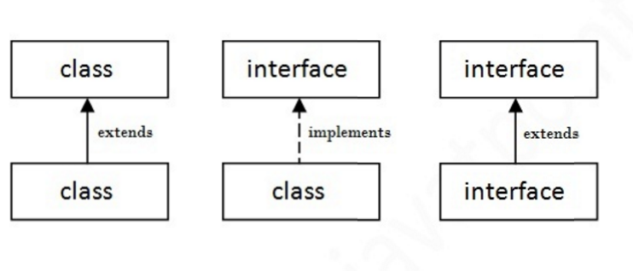
Understanding relationship between classes and interfaces

Slide 95
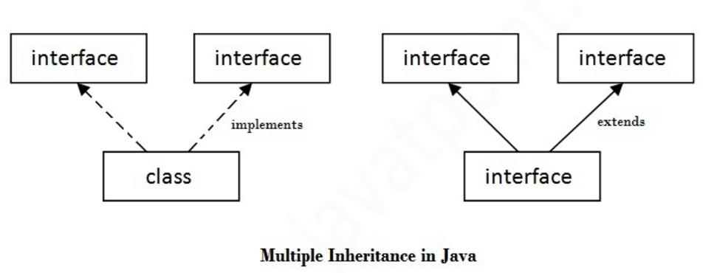
Multiple inheritance in Java by interface
If a class implements multiple interfaces, or an interface extends multiple interfaces i.e. known as multiple inheritance.

Slide 96
Collection
What is Collection?(java 1.5)
It is dynamic data structure
It added after java 1.5
Collection in java is a framework that provides an architecture to store and manipulate the group of objects.
All the operation that you perform on data such as searching,sorting,insertion,manipulation,deletion etc. can be performed by java collection.
Java collection simply means a single unit of objects.

Slide 97
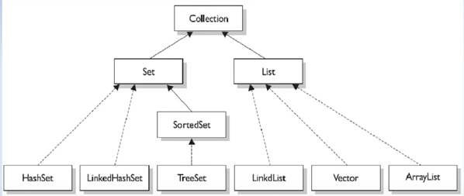
Collection

Slide 98
Generic In Collection
Java new generic collection allows you to have only one type of object in collection.
Now it is type safe so typecasting is not required at run time.
Non-Generic Arraylist
Arraylist al=new Arraylist();
Generic Example:
Arraylist<string> al=new Arraylist<String>();
In generic collection we specify type in angular braces .Now arraylist is forced to have only specified type of object in it.
If you try to add another type of object,it gives compile time error.
Demo

Slide 99
What is List and Arraylist
List:- List is an interface
Arraylist:- Is a class & implements List.
ArrayList uses a dynamic array to store objects.
What is Arraylist?
Java Arraylist is non-synchronized
Java Arraylist class can contain duplicate elements
Java Arraylist class maintains insertion order.
Java arraylist allows random access because array works at index basis
In java Arraylist class manipulation is slow a lot of shifting need to be occurred if any element is removed from the Arraylist
Order by index and duplication allowed

Slide 100
Vector
Vector stores data elements in a dynamic array.
It resembles an ArrayList.
It is synchronized though, and has lot of methods that are not included in the collection framework.

Slide 101
LinkedList
LinkedList class implements List interface.
Internally elements are stored in doubly linked list.
It implements all List operations,& permits all elements including null.
LinkedList is non-Synchronized.
This class provides methods to get,remove and insert an element at the beginning and the end of the list.
Linkedlist manipulation is fast because no shifting is required.
Order by index and duplication allowed
addFirst(),addLast(),getFirst(),getLast()

Slide 102
Set(collection) in java
What is Set?
Set interface in java which extends collection interface.
Set collection in java does not allow duplicate values.
Set is unordered collection.
Can’t be accessed using index.
Methods used in Set interface
add( ) Adds an object to the collection
clear( ) Removes all objects from the collection
contains( ) Returns true if a specified object is an element within the collection.
isEmpty( ) Returns true if the collection has no elements
remove( ) Removes a specified object from the collection.
size( ) Returns the number of elements in the collection.

Slide 103
Set
Set have its implementation in various classes like HashSet, TreeSet, LinkedHashSet.
Program:
Set setA= new HashSet();
String element = "element 1"; setA.add(element);
System.out.println( setA.contains(element) );

Slide 104
HashSet
HashSet extends AbstractSet and implements the Set interface.
It creates collection that uses a hash table for storage & value stored as per hash function.
Advantages of HashSet is that it performs basic operations(add , remove ,contains & size).
Not ordered and duplication is not allowed.
Faster than TreeSet

Slide 105
TreeSet
This class implements SortedSet interface.
It is useful when you need to extract elements from a collection in a sorted manner.
The elements are internally stored in a search tree which guarantees elements are accessed according to the natural order of the elements or by comparator provided at set creation time.
Sorted and no duplication is allowed.
decendingSet(),headSet(),tailSet(),subSet(),First(),
Last()

Slide 106
LinkedHashSet
This class extends HashSet class
It maintains the order of the items added to the set.
It use for maintaining by doubly linked list.

Slide 107
Map Interface
A Map represents an object that maps keys to values.
A map cannot contains duplicate keys; each key can map to at most one value.
It does not extend the Collection interface.
The Map interface provides three collection views which allow a maps contents to be view as a set of keys, collection of values or set of key-value mappings.

Slide 108
HashMap
HashMap basically designates unique keys to corresponding values that can be retrieved at any given point.
Features
The values can be stored in a map by forming a key-value pair. The value can be retrieved using the key by passing it to the correct method.
If no implementation exits in map it will throw a “No such element Exception
HashMap stores only object reference. That is why it is impossible to use primitives data types like double or int.

Slide 109
HashMap
Methods
get(objectkey)
This will return the value associated with a specified key in this java HashMap.
Put(objectkey, string value)
This method stores specified value & associates it with the specified key in this map.

Slide 110
Exception Handling in java
What is Exception?
In plain English ,exception is abnormal condition.
In java also exception is abnormal scenario which will stop the execution of current program.
In technical word Exception is a class in java
What is Exception Handling in java?
Exception handling is a way to handle runtime / compiletime/errors/IOExceptions, ArithmaticException & so on.
Main reason of exception handling is to maintain the normal flow of the application.

Slide 111
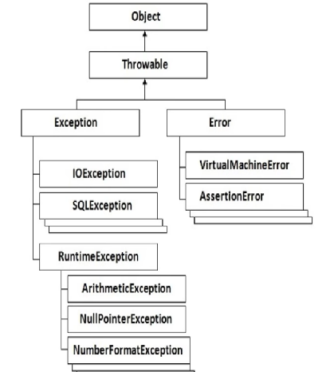
Hierarchy of Java Exception Class

Slide 112
Types
Check Exception:
Checked exception are checked at compile time.
Uncheck Exception:
Unchecked exception are checked at run time.
Error:
Error is irrecoverable.
Example: OutofMemoryError, VirtualMachineError, AssertionError & so on.

Slide 113
Java Exception Handling Keywords
1. try
2. catch
3. throw
4. throws
5. finally

Slide 114
Try-catch block(runtime)
Java try block must be followed by either catch or finally block
Syntax:
try
{
//code that may throw exception
} catch(Exception_class_Name ref){ }
Or
Try –finally block
try
{
//code that may throw exception
} finally { }

Slide 115
Throws Keyword
Java throws keyword is used to declare an exception.
It gives an information to programmer there may occur on exception so it is better for programmer to provide exception handling code ,so that normal flow can be maintained.
Exception handling mainly used for handling checked Exceptions.

Slide 116
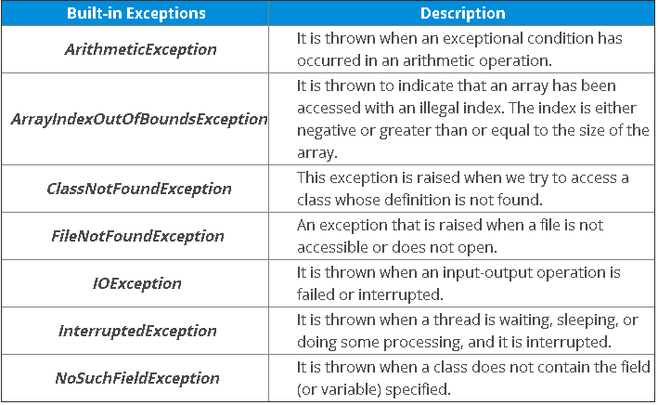

Slide 117
